Slide 1
RUNGTA COLLEGE OF DENTAL SCIENCES AND RESEARCH
Cavity Varnishes, Liners and Bases
DEPARTMENT OF CONSERVATIVE DENTISTRY AND ENDODONTICS

Slide 2
Specific learning Objectives
At the end of this presentation the learner is expected to know ;
Core areas* | Domain ** | Category #
Introduction | Cognitive | Must know
Definitions | Cognitive | Must know
Classifications of liners and bases | Cognitive | Must know

Slide 3
Overview
Introduction
Definitions of Cavity Varnish, Liner and Base
Pulp protection.
Classifications of liners and bases
Ideal requirements of liners and bases

Slide 4
Cavity Varnish: composition, application, indication, contraindications, advantages, disadvantages.
Cavity Liners: composition, application, indications, contraindications , advantages, disadvantages.
Cavity Bases: Types, composition, manipulation, method of application, indications , contraindications.
Pulp protection procedures: direct and indirect pulp capping.

Slide 5
CAVITY VARNISH
Composition:
- Natural gum- copal ,
- Synthetic resin-nitrated cellulose,
- Solvents- chloroform, alcohol, acetone, benzene, toluene , ethyl acetate, and amyl acetate.
- Medicinal agent- chlorobutanol , thymol ,and eugenol also have been added.

Slide 6
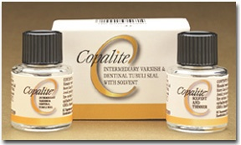

Slide 7
CAVITY VARNISH
Method of application:
Applied by using a small cotton pellets and cotton pliers or root canal reamers as carriers, camel’s hair brush or wire loop.
Several thin layers are applied.
Each layer is allowed to dry by gentle stream of air before applying another layer.
Two thin layers have been found to be more protective than one layer.

Slide 8
Indications:
Use on dentinal surfaces to minimize penetration of acid from zinc phosphate cements .
Used on enamel and dentinal walls to reduce the penetration of oral fluids around metallic restorations.
Varnish may be used as a surface coating over certain restorations to protect them from dehydration or contact with oral fluids.

Slide 9
Contraindications:
Composite restorations
GIC restorations.
Silicate cements-inhibit uptake of fluoride by enamel.

Slide 10
Advantages:
Reduces leakage around the margins and walls of metallic restorations, this minimizes post operative sensitivity.
Varnishes have low solubility.

Slide 11
Disadvantages:
Reduce but do not prevent passage of constituents of phosphoric acid cements into underlying dentin.
Neither possess mechanical strength nor provide thermal insulation.
They do not bind to tooth structure.

Slide 12
CAVITY LINERS
Composition
Suspensions of calcium hydroxide in an organic liquid such as methyl ethyl ketone or ethyl alcohol or in aqueous solution of methyl cellulose.
Liners may also contain acrylic polymer beads or barium sulfate.
Fluoride compounds like calcium monofluorophosphate have been added to some liners.

Slide 13
Method of application:
Cavity liners are fluid in consistency and are easily painted over dentinal surfaces. The solvents evaporate to leave a thin film residue that protects the underlying pulp.

Slide 14
Indications:
Calcium hydroxide liners -lining deep cavities
Direct and indirect pulp capping agents- Calcium hydroxide liners.
ZOE liners in deep cavity to retard penetration of acids.

Slide 15
Contraindications:
Calcium hydroxide liners not used on margins of restorations
ZOE liners not used under composite restorations.

Slide 16
Advantages:
Calcium hydroxide liners- dentin bridge formation.
ZOE sedative effect on pulp.
Fluorides can be added to liners
Disadvantages:
Calcium hydroxide liners are soluble.
Low tensile and compressive strengths.

Slide 17
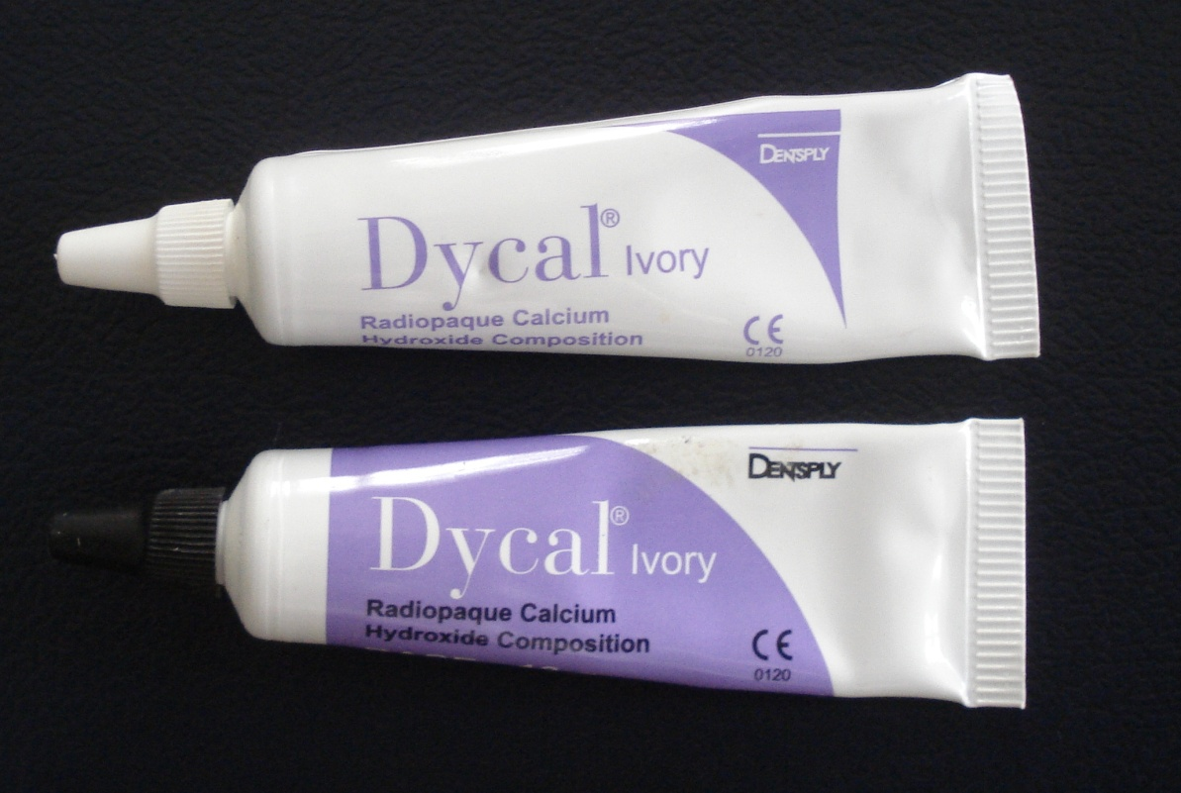
Dycal
Type of Cement : Calcium Hydroxide Mixing Ratio : Base : Catalyst 1.17g : 1.0g Indications : Vital pulp capping, pulp protection liners under restorative materials Mixing Time : 10 sec Working Time : 2 mins 20 sec Setting Time : 2.5 to 3.5 mins

Slide 18
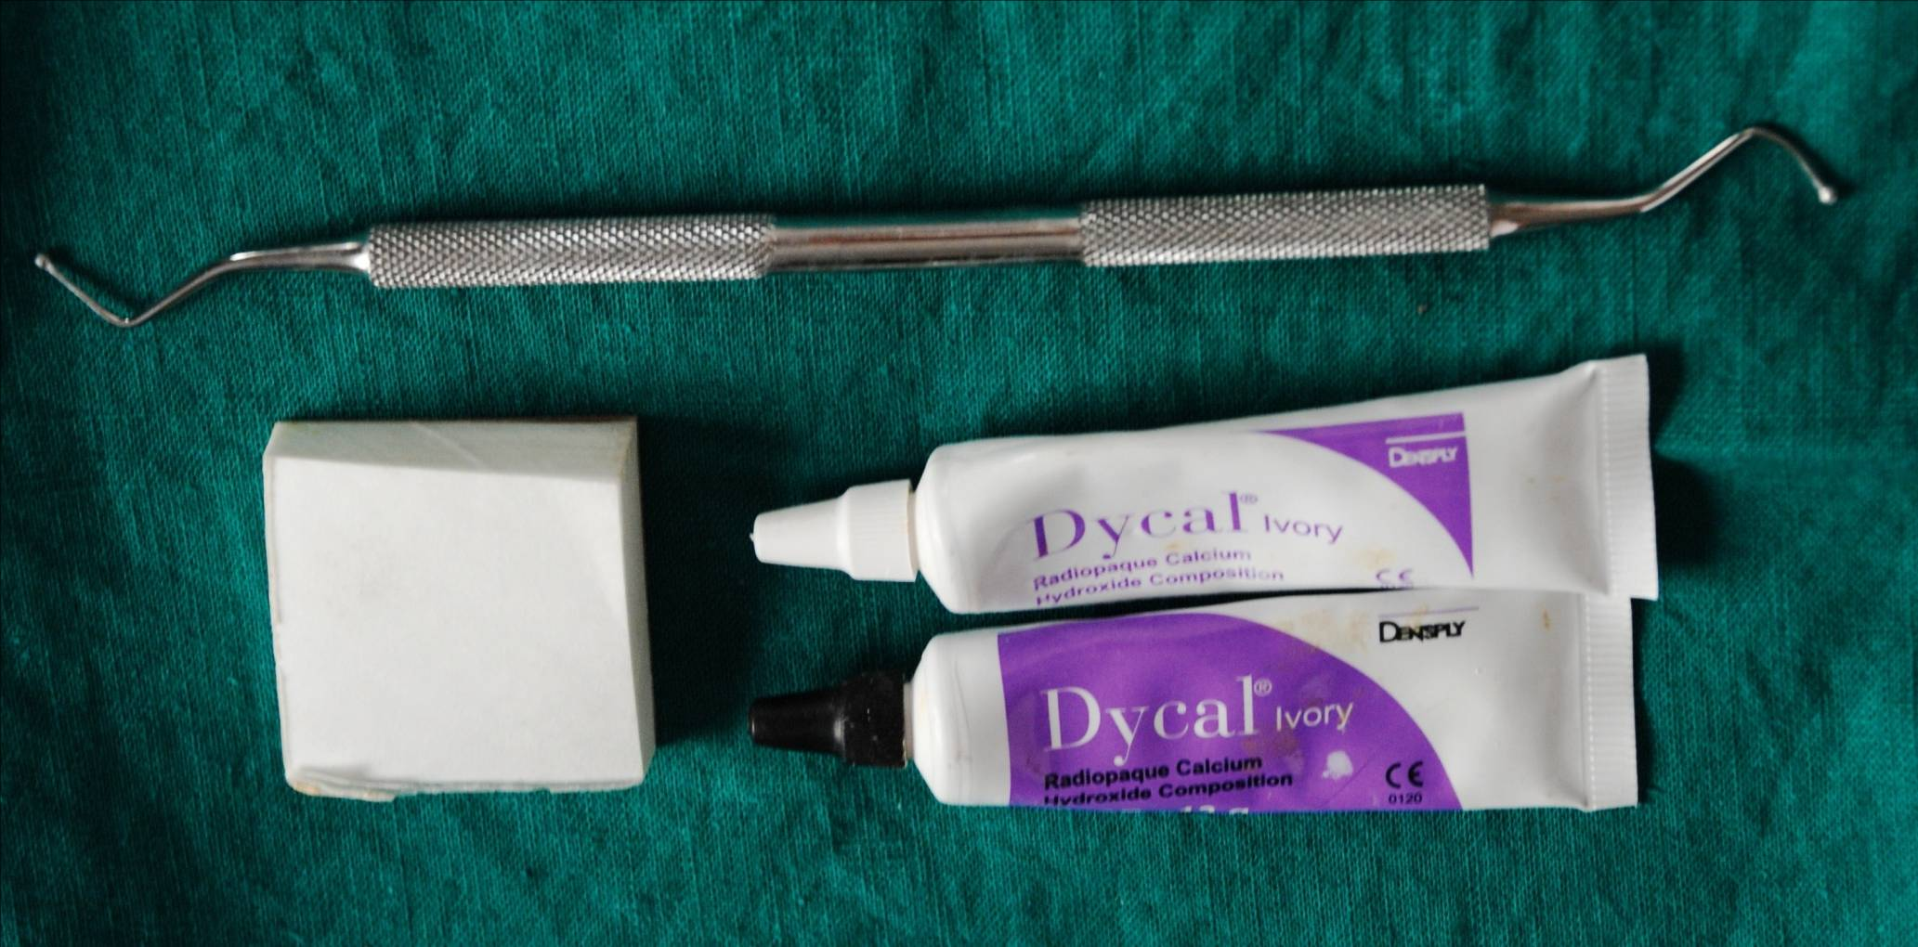
Manipulation –materials

Slide 19
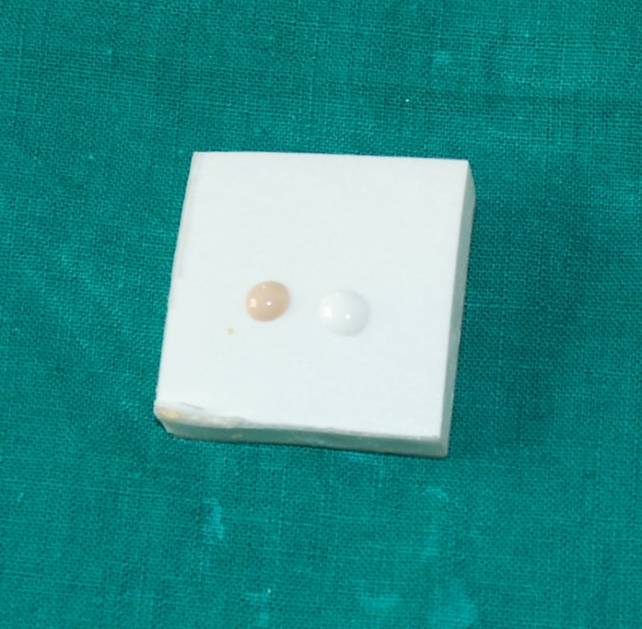
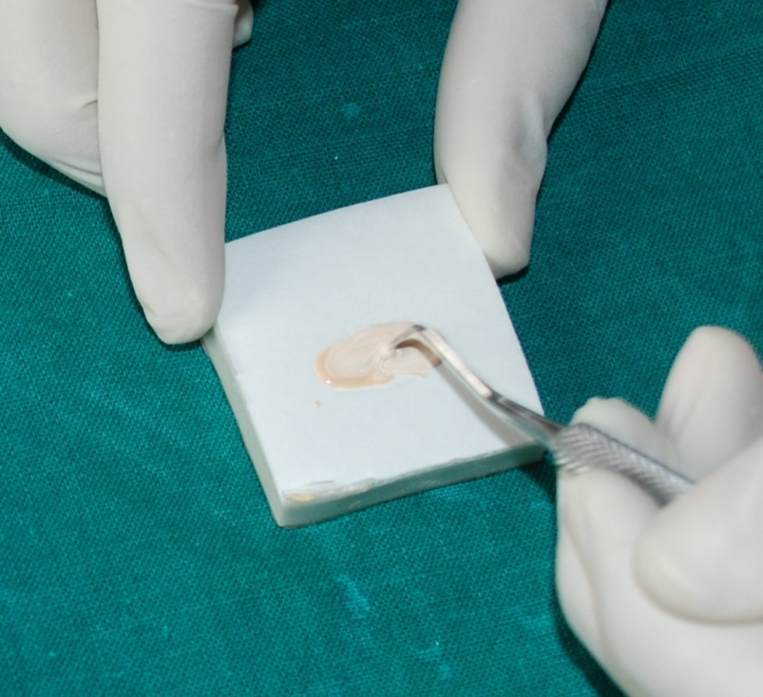
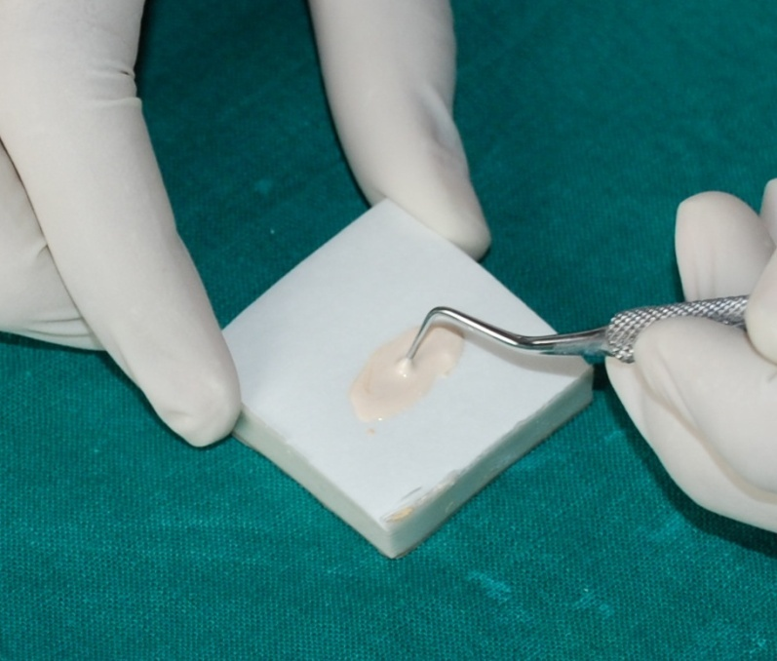

Slide 20
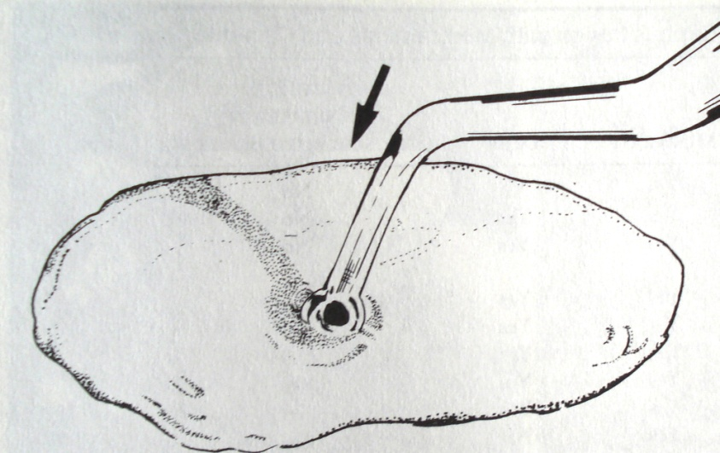
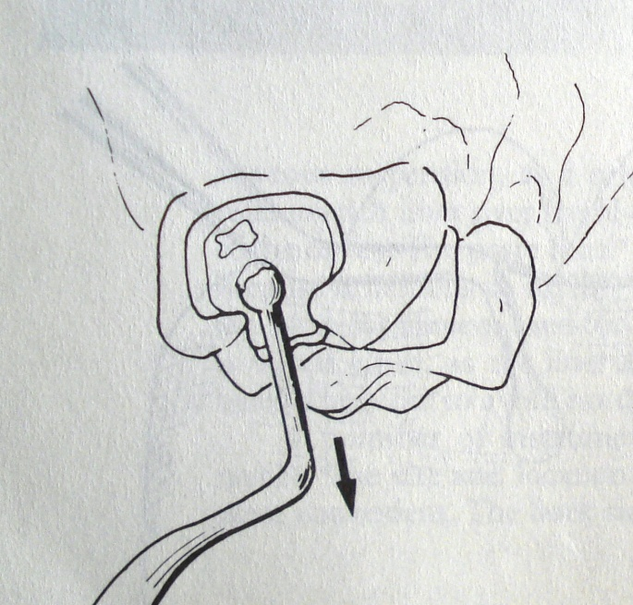
Method of application

Slide 21
CEMENT BASE
Thickness- 1 to 2mm.
Provide thermal protection, mechanical support and pulp medication.
They form seats which help distribute stresses laterally, away from underlying weaker structures.

Slide 22
CEMENT BASE
Types:
High strength bases:
Resist occlusal forces and condensation forces along with thermal protection. They have high modulus of elasticity.
Zinc phosphate,
Zinc polycarboxylate,
Glass ionomer, and
Reinforced ZOE cements.

Slide 23
2. Low strength bases:
They have low modulus of elasticity hence do not resist condensation and occlusal forces effectively, but provide thermal insulation.
Calcium hydroxide
Zinc oxide eugenol.

Slide 24
High Strength Bases:
Material | Composition
Zinc phosphate | Powder –zinc oxide(90%), magnesium oxide(10%) Liquid- phosphoric acid, water, alluminium phosphate some times zinc phosphate(acid content 33+/_ 5wt%
Zinc polycarboxylate | Powder- zinc oxide, magnesium oxide/stannic oxide,bismuth, alluminium. Stannous fluoride. Liquid- Polyacrylic acid or copolymer of acrylic acid with other carboxylic acid such as itaconic acid.(acid concentration 32% to 42% by wt)
Glass ionomer | Powder- calcium fluroaluminosilicate glass (SiO2, Al2O3, AlF3, CaF2,NaF,AlPO4) lanthanium,barium,strontium Liquid-polyacrylic acid in form of copolymer with itaconic, maleic,or tricarboxylic acids, tartaric acid,water.

Slide 25
High strength bases
Material | Composition
Resin modified GIC (light cured) Resin modified GIC(self cured) | Powder:calcium fluroaluminosilicate glass ,chemical/and light activated initiators Liquid: polyacrylic acid, water-soluble methacrylate monomer,water,activator. Or two pastes. Powder- fluroalluminosilicate glass,microencapsulated potassium persulfate and ascorbic acid catalyst system. Liquid – aq. polycarboxylic acid, HEMA, tartaric acid
Polymer reinforced ZOE | Powder: zinc oxide, polymethyl methacrylate Liquid:eugenol

Slide 26
Low strength bases
Material | Composition
Calcium hyroxide (self cured) Calcium hydroxide (light cured) | Base paste- calcium tungsate, tribasic calcium phosphate,and zinc oxide in glycol salicylate. Catalyst paste- calcium hydroxide, zinc oxide and zinc stearate in ethylene toluene sulfonamide. One paste- calcium hydroxide and barium sulfate in urethane dimethacrylate resin.
Zinc oxide-Eugenol(type III) | Powder- zinc oxide,white rosin,zinc stearate, zinc acetate Liquid- Eugenol, Olive oil.

Slide 27
Properties: High strength bases
Material | Compressive strength (MPa) | Tensile strength(MPa) | Modulus of elasticity(GPa)
Zinc phosphate | 130-160 | 8 | 22
Zinc polycarboxylate | 80 | 16 | 5
Glass ionomer | 70-210 | 3.9-8.3 | 3.7-9.0
Resin modified GIC | 150-200 | 20-40 | 8-20
Polymer reinforced ZOE | 38 | 3.4 | 2.1

Slide 28
Properties :Low strength Bases
Material | Compressive strength(MPa) | Tensile strength(MPa) | Elastic modulus(Gpa)
Calcium Hydroxide(light cured) | 96 | 38 | -
Calcium hydroxide(self cured) | 12-26 | 1 | 0.4
Zinc oxide eugenol (type III) | 5.5 | 0.41 | 0.3

Slide 29
Take home message
It is important to protect pulp from chemical, electrical and thermal insults in order to avoid any post operative pain and complications.
The pulp protecting agent should also provide some medicative effect to the pulp.
Hence, understanding the properties and method of application of these agents is important.

Slide 30
QUESTIONS
Define cavity varnish, liner and base
Classify cavity varnish
Classify cavity base
What is the importance of remaining dentin thickness (RDT)
Method of application of cavity varnish
Composition of dycal

Slide 31
REFERENCES
Science Of Dental Materials -----By ANUSAVICE, Skinners.
Restorative Dentals Materials 11th Edition By Craig.
Operative Dentistry 2nd Edition By Summit, Robbins, Schwarts

Slide 32
SUGGESTED READING
Science Of Dental Materials -----By ANUSAVICE, Skinners.
Restorative Dentals Materials 11th Edition By Craig.

